Slide 1
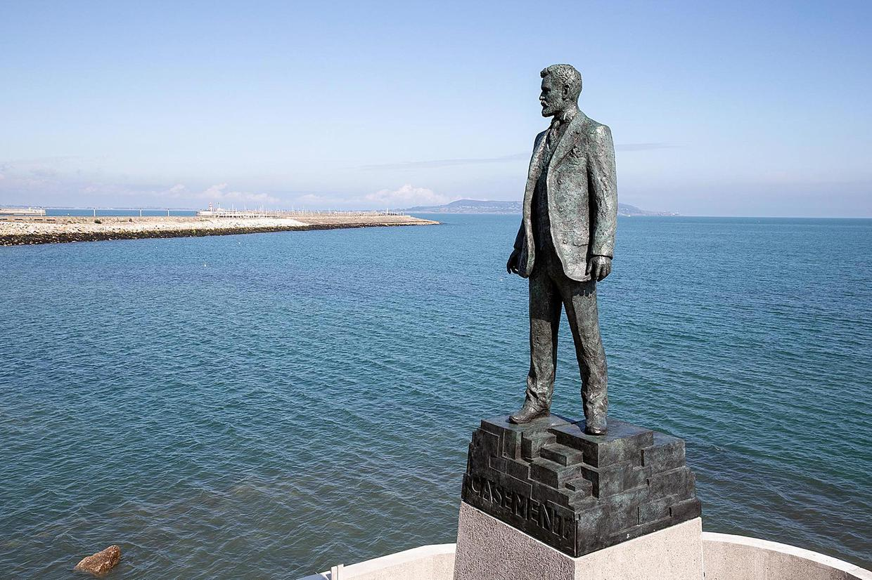
Roger Casement –
Hero or Villain ?
Sort the following sentences according to the two categories: hero or villain.
Sort the following sentences according to the two categories: hero or villain.

Slide 2
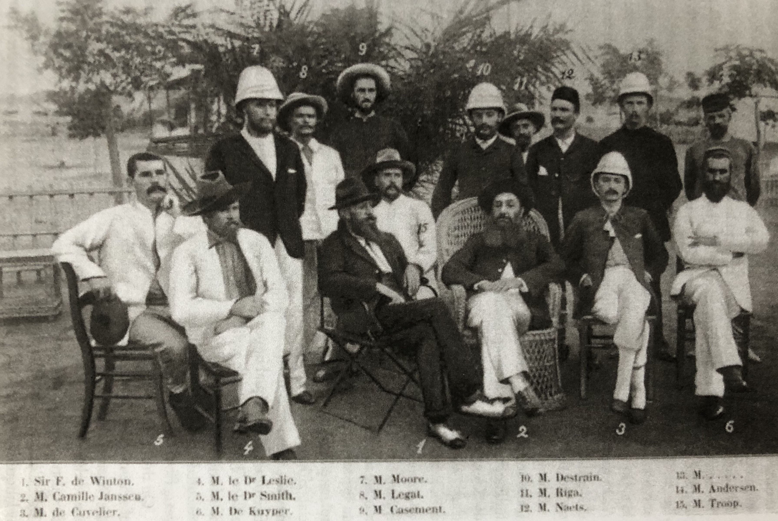
1) When he was 19 years old, he worked for King Leopold‘s International African Association to colonise the Upper Congo.
2) He surveyed the Lower Congo in preparation for the construction of a railway line.
3) He led expeditions into unexplored territories in Africa and produced detailed maps of these areas that were then published by the War Office of Britain and used to colonise and exploit these areas.
Roger Casement
(at back, marked 9)
with other Congo Free State officials, ca. 1886

Slide 3
4) He compiled a report on atrocities in the Congo that mobilised international action to free the Congo and end the misery.
5) He risked his career and life to compile the Congo report.
6) He was knighted for his important investigations on human rights abuses in the rubber industry (Congo and Peru).
7) He was named a pioneer in the field of anthropology and ethnography for his outstanding contributions.
8) Even though he knew under which hard conditions meat (eg. antelope) was produced and hunted in the Congo (women were taken hostage if the men could not hand in enough rubber or food supplies) he gladly accepted half an antelope.

Slide 4
9) His ethnographic notes described West African customs as ‘savage’ and ‘evil’, and said that West African customs and ‘life [were] little better than animal’ (6 June 1894). He further wrote: “The Ibibios [in Nigeria] are a dirty misshapen very very ugly race.”
10) He usually travelled unarmed.
11) He joined ivory-gathering expeditions and was an elephant hunter.
12) When he was 28 years old, he wrote: "We all on earth have a commission and a right to defend the weak against the strong and to protest against brutality in any form.”

Slide 5
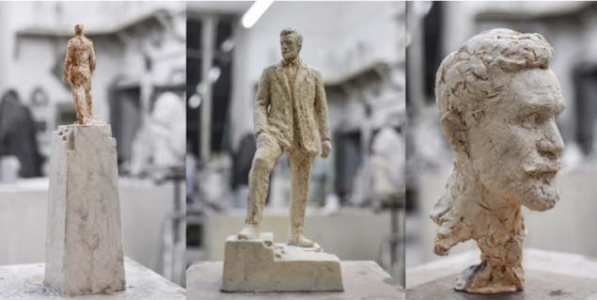
He helped found the same colony that he later tried to liberate? Isn’t that ironic?
Controversial and hypocritical?
Should he be remembered with a statue? Or should his statue be taken down – like King Leopold’s?

