Slide 1

Broadcast begins at 9.30 a.m.
English Studies
at the University of Zurich (UZH)
Dr. des. Martin Mühlheim (English Department UZH) – englishstudies@es.uzh.ch

Slide 2



Slide 3
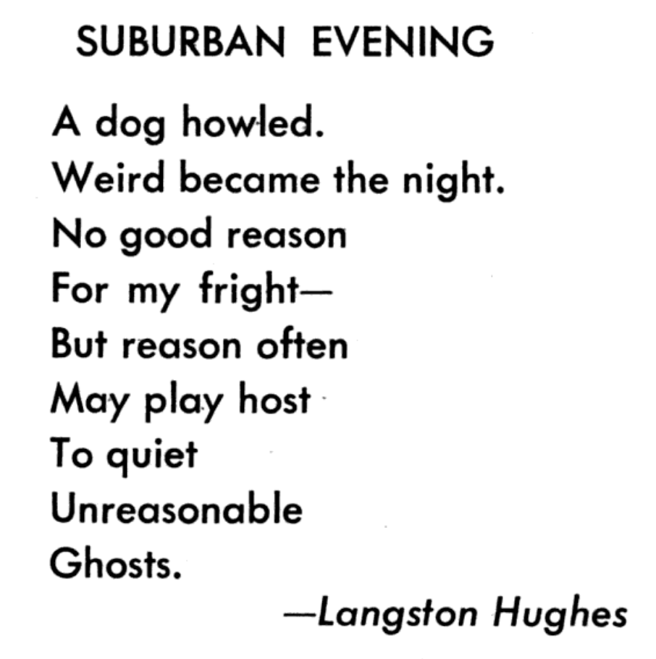

Slide 4


Slide 5
Bachelor and Master Programs
Bachelor of Arts (B.A.)
Total of 180 credit points
6 semesters full-time study
Master of Arts (M.A.)
An additional 120 credit points
A further 4 semesters full-time study

Slide 6
Bachelor (180 ECTS): Subject Distribution
Major
Minor
Major
Minor
a)
English Literature and Linguistics
+
b)
+
English Literature and Linguistics
60 ECTS
60 ECTS
90 ECTS
120 ECTS
120 ECTS

Slide 7
Bachelor: 60-ECTS Minor
Introduction to Linguistics I & II 9 ECTS
English Literature: Textual Analysis I & II 9 ECTS
Language Skills & Culture: Introduction I & II 12 ECTS
Foundation Studies
= 30 ECTS
= 30 ECTS
60 ECTS
Main Studies

Slide 8
Bachelor: 60-ECTS Minor
Introduction to Linguistics I & II 9 ECTS
English Literature: Textual Analysis I & II 9 ECTS
Language Skills & Culture: Introduction I & II 12 ECTS
Foundation Studies
= 30 ECTS
History of the English Language 1: Focus on Old English
History of the English Language 2: Focus on Middle English
Literature in Context: History and Theory
1 Bachelor Seminar in English Literature
Writing Skills and Media Analysis
= 30 ECTS
60 ECTS
Main Studies

Slide 9
Master Programs: Brief Overview
English Literature
and/or Linguistics
Mono-Master in Literature
Mono-Master in Linguistics
90 ECTS
30 ECTS
120 ECTS
120 ECTS

Slide 10
Timetable Considerations
No more than 30 ECTS each semester
Fewer ECTS if you are working as well
Halve the ECTS for two-semester courses
Check for mandatory modules in your Major in the spring semester
Latin no longer mandatory – but Major students can take it at UZH
→ module group ‘Transferable Skills’

Slide 11
Minimum Requirements for Lehrdiplom
English as first or only teaching subject
at least 45 ECTS in English at Master Level
a Master Thesis in English Studies (either Literature or Linguistics)
overall, at least 21 ECTS each in English Literature and in English Linguistics
“Language Skills for Teachers” (3 ECTS) + stay abroad (min. 6 months)
English as second teaching subject
at least 30 ECTS in English at Master Level
overall, at least 21 ECTS each in English Literature and in English Linguistics
“Language Skills for Teachers” (3 ECTS) + stay abroad (min. 6 months)

Slide 12
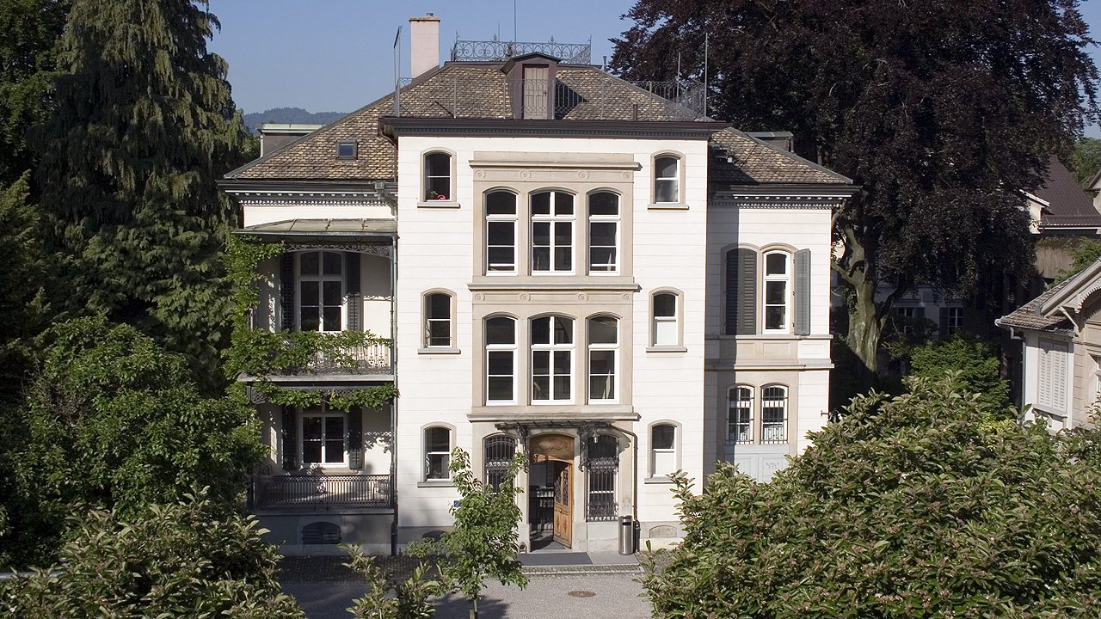
Building PLH (Plattenstrasse 47, 8032 Zürich)

Slide 13
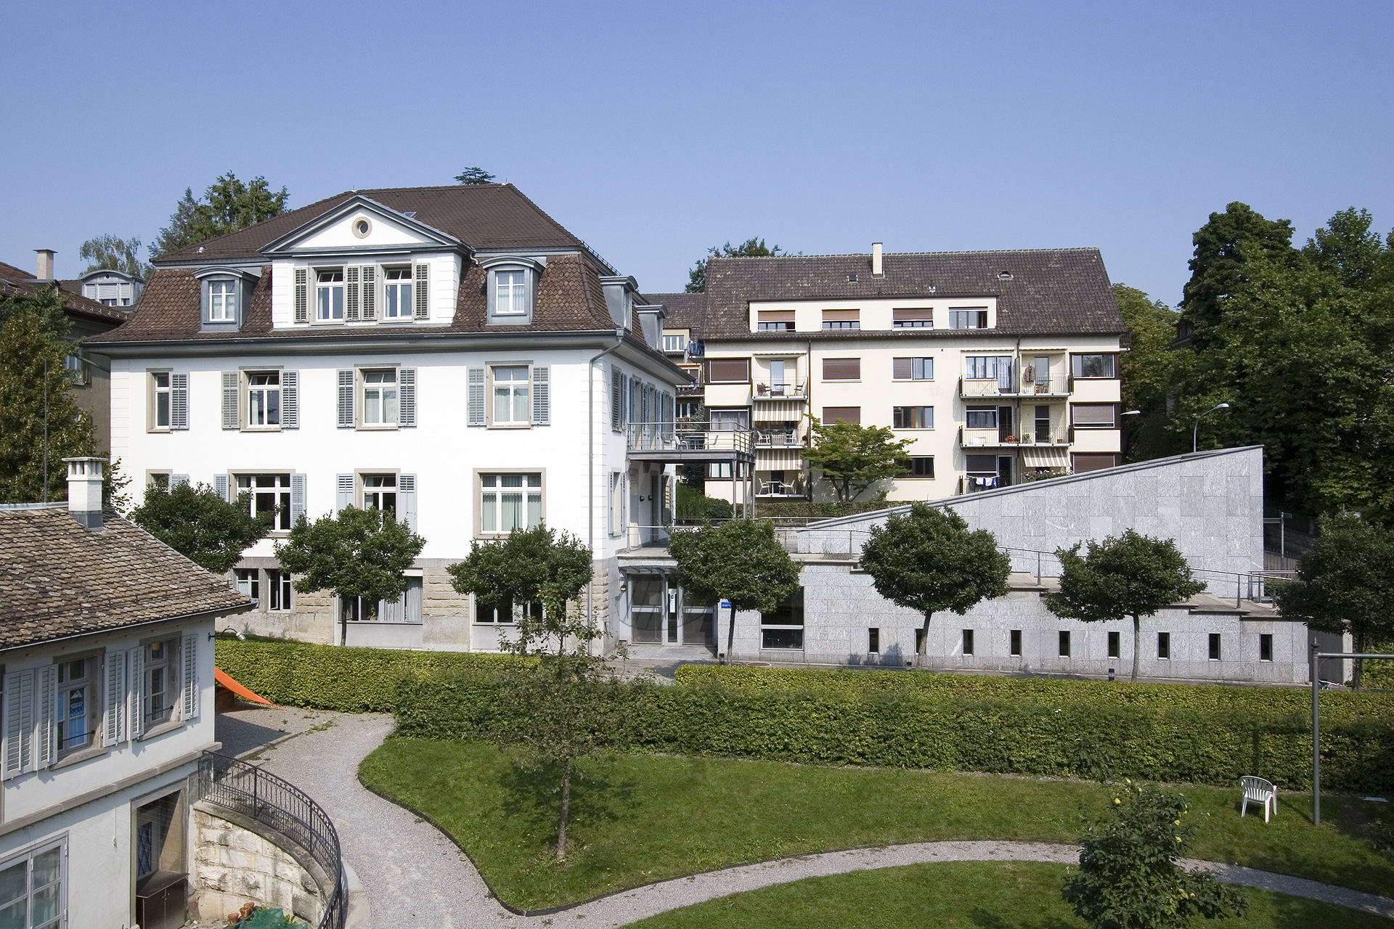
Building PET (Pestalozzistr. 50), 8032 Zürich)

Slide 14
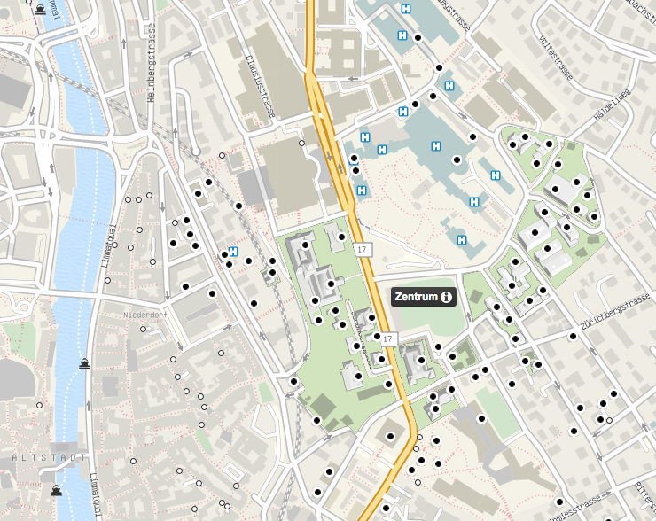
Distance from UZH Main Building: c. 5–10 min
KOL
PLH

Slide 15
English Department Staff
9 Professors: 4 in Linguistics, 5 in Literature
5 Oberassistierende / Post-Doctoral Researchers
3 IT-Coordinators
5 Language Instructors
13 Assistants
3 Librarians
3 Secretaries
Lehrbeauftragte
Of all the English Departments at Swiss universities, the one at the UZH offers the broadest range of courses.

Slide 16
Useful Contacts
Secretary’s Office: Angelika Kapfer (sekretariat@es.uzh.ch, PLH-2)
Advising of Studies: Martin Mühlheim (englishstudies@es.uzh.ch, PLH-103)
Language Skills & Culture: Shane Walshe (PET-102)
Textual Analysis: Zoë Lehmann (PET-2)
Introduction to Linguistics: Susanne Flach (PLH-207)
Study Abroad: Nathalie Meyer (studyabroad@es.uzh.ch, PLH-103)

Slide 17
Advising of Studies
Please read the information on the website very carefully: www.es.uzh.ch/en/studies/bachelor.html
If anything remains unclear, fill in the form at www.es.uzh.ch/en/studies/advisingstudies.html
Send the sign-up form to: englishstudies@es.uzh.ch

Slide 18
Online Contact and Resources
Identity Manager: www.identity.uzh.ch
For course material: www.olat.uzh.ch → Log on as soon as possible!
You must check your email account regularly (at least once a week): https://webmail.uzh.ch

Slide 19
Useful Services (I)
Jobs: www.uzh.ch/studies/studentlife/vacancies.html
Zentralbibliothek: www.zb.uzh.ch → The ES also has its own library!
Language Learning Center: www.sprachenzentrum.uzh.ch
Akademischer Sportverein: www.asvz.ch
Housing Office of the University / ETH Zurich: www.wohnen.ethz.ch/en.html

Slide 20
Useful Services (II)
Psychological Counseling Services: www.pbs.uzh.ch/en.html
Disability Office: www.disabilityoffice.uzh.ch/en.html
Student Financial Aid Office: www.studienfinanzierung.uzh.ch/en.html
General Student Advisory Services: http://www.studienberatung.uzh.ch/en.html

Slide 21


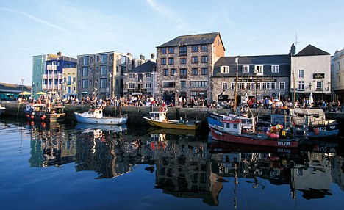




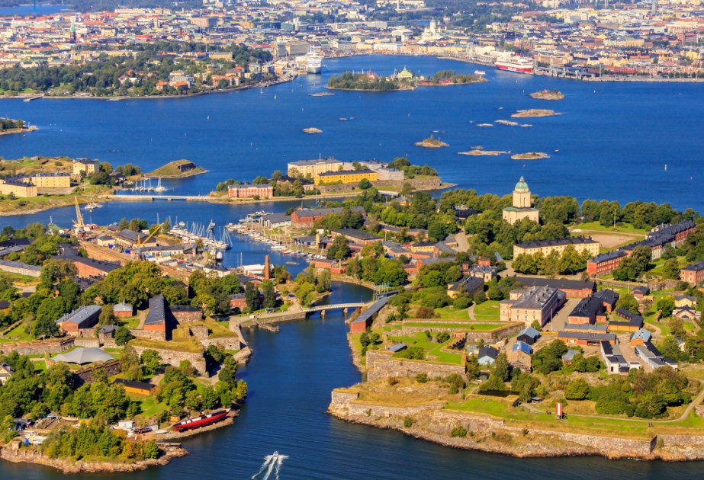
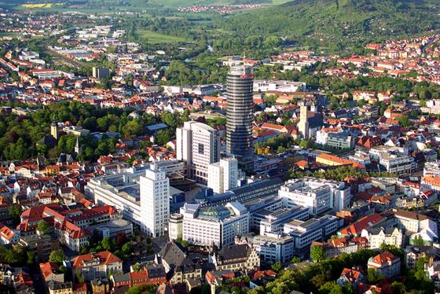




International Contacts: Exchange
+ faculty- and university-wide agreements
Outside Europe
Halifax (Canada)
Aberdeen
Manchester
Plymouth
Sheffield
Auckland
(New Zealand)
Dublin
Barcelona
Cluj
Helsinki
Jena
Tampere
Vienna
London
Warwick
European Partners

Slide 23
Study Abroad
Start planning early
Do not plan the stay abroad in the first two semesters of your English studies
Pflichtkurse must be done in Zurich
Discuss your stay abroad beforehand (N. Meyer, studyabroad@es.uzh.ch)
International Relations Office: www.int.uzh.ch
Study Abroad Information:
October 27, 6 p.m.

Slide 24

The ES Alumni Student Fund
The ES Alumni Student Fund supports academic and study-related projects by Bachelor and Master students of English Literature and/or Linguistics. Examples include:
student research projects;
small travel bursaries (e.g. for field work, or to attend an academic conference);
course-related excursions (max. CHF 50.- per student).

Slide 25
Language Skills and Cultural Studies
LS&CS Lecture (aspects of British & American culture)
    Every two weeks (alternating with Textual Analysis) (see schedule)
    Begins in Week 2 (Tues 22 Sept 2020)
    Obligatory for all
    Lecture forms the basis for exercise and homework in the LS&CS course and for the final exam
Writing Skills and Cultural Studies
    12 groups, every week obligatory for all
    Introduces key components and conventions of academic writing and key concepts in cultural studies
Notes:
Module aims primarily at improving your language skills - giving you the necessary skills in writing English that you will need for other parts of your degree (will also be required to write in English in other elements of your English degree.
Culture: aims also to give you solid grounding in British and American culture (we can only offer expertise in these) - provides the content for the language work.
Number of different component courses for this module, some are obligatory for all:
Lecture - fortnightly, 2 hours: taught by Frances Ilmberger (US) and David Matley (UK) in alternation. Will look at particular area of society and culture from US perspective one week / British perspective two weeks later.
As this provides content for rest of language work, it is obligatory for all - cannot afford to miss it!!!
Begins in week 2 (on Tuesday afternoons).
Writing course - weekly, 2 hours: composition exercises, teaching you about all aspects of academic writing (language, but also structuring an essay correctly, writing correct paragraphs, correct formatting, referencing, etc.)
12 parallel groups (can choose from one of 8 times)
obligatory for all
begins week 1, so important that you book this course SOON! Online booking system. If you’re unsure about how to proceed, two websites give you an idiots guide (not suggesting that you’re idiots - but will hold your hand through it)

Slide 26
Tutorials
From week 3
Taught by students in advanced semesters
Review texts for the lecture and the writing course
Thorough and individual help on your writing, language, and grammar
Times and tutors: announced on OLAT and on the ES website as well as on the notice board in the ES department
Notes:
Students in advanced semesters, with very good English. And have been through the programme themselves.
Means that they can advise you on language as well as content, structure, etc. Give you all kinds of insider tips on how to pass the module
We cannot correct all of your work (you don’t want a nasty surprise when you hand in work at the end of term - for thorough and regular feedback, you need to contact a tutor.
Not obligatory but highly recommended!

Slide 27

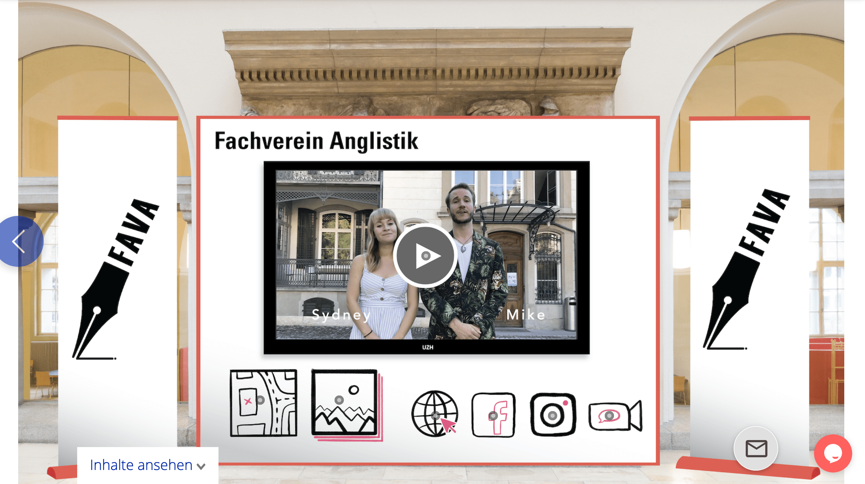
FAVA: Fachverein Anglistik
https://erstsemestrigentage-uzh.expo-ip.com/stand/1147
Live chats from 12.00 (i.e. noon)
www.favauzh.ch

Slide 29
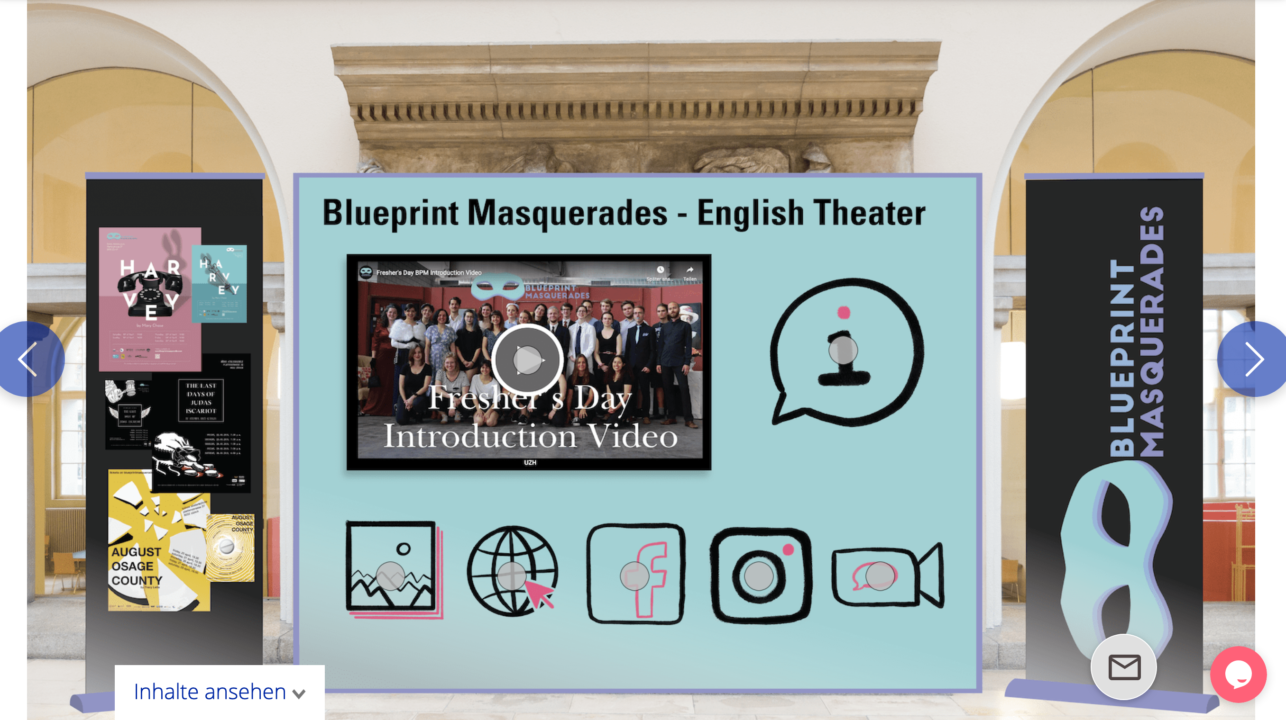
https://erstsemestrigentage-uzh.expo-ip.com/stand/1113

Slide 30
English Department
University of Zurich
Plattenstrasse 47
CH-8032 Zürich
phone +41 44 634 3551
e-mail englishstudies@es.uzh.ch
web: www.es.uzh.ch

